Slide 1

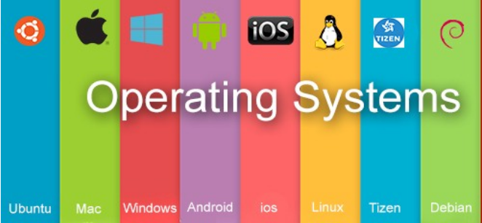
Operating System BCSC0004
Ajitesh Kumar
Assistant Professor
GLAU

Slide 2
OS Function and OS Structure

Slide 3
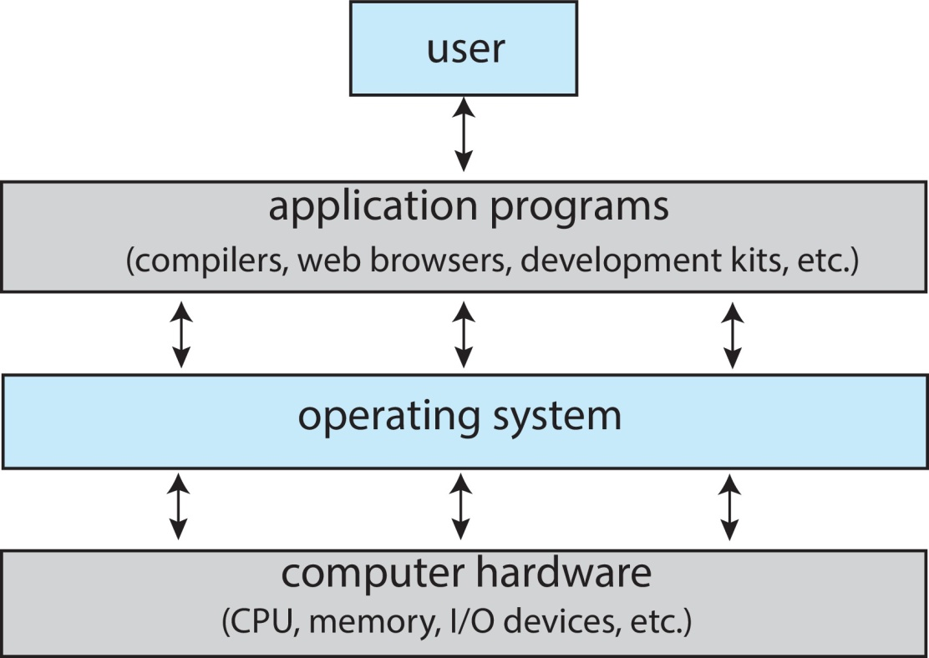

Slide 4
Function of OS
Memory Management
Keeps tracks of primary memory, i.e., what part of it are in use by whom, what part are not in use.
In multiprogramming, the OS decides which process will get memory when and how much.
Allocates the memory when a process requests it to do so.
De-allocates the memory when a process no longer needs it or has been terminated.
Allocate and free memory

Slide 5
Processor Management
Keeps tracks of processor and status of process. The program responsible for this task is known as traffic controller.
Allocates the processor (CPU) to a process.
De-allocates processor when a process is no longer required.
End , abort, Load, Execute, Create process, terminate process,

Slide 6
Device Management
Keeps tracks of all devices. Program responsible for this task is known as the I/O controller.
Decides which process gets the device when and for how much time.
Allocates the device in the efficient way.
De-allocates devices.
Request device , release device, Read , write , Get device attributes, Set device attributes

Slide 7
File Management
Keeps track of information, location, uses, status etc. The collective facilities are often known as file system.
Decides who gets the resources.
Allocates the resources.
De-allocates the resources.
Create file, Delete file, Open , close, Read, write, Get file attributes, Set file attributes

Slide 8
Operating-System Structures
Simple
2. Layered

Slide 9
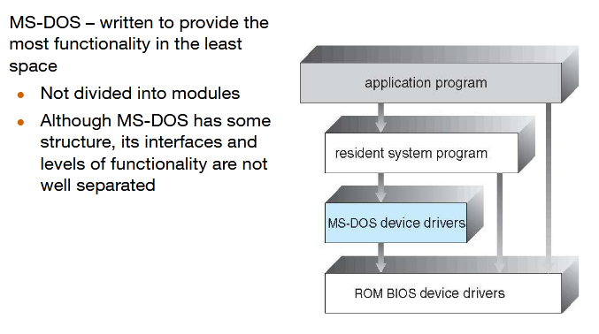
Simple Structure -- MS-DOS

Slide 10
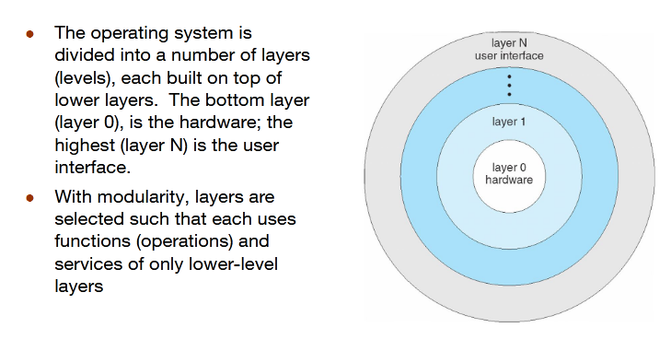
Layered Approach

Slide 11
Kernel
Kernel is central component of an operating system that manages operations of computer and hardware.
Objectives of Kernel :
To establish communication between user level application and hardware.
To decide state of incoming processes.
To control disk management.
To control memory management.
To control task management.
Types of Kernel :
1. Monolithic Kernel –
It is one of types of kernel where all operating system services operate in kernel space. It has dependencies between systems components. It has huge lines of code which is complex.
Example:
Unix, Linux, Open VMS, XTS-400 etc.
Advantage: It has good performance.
Disadvantage: It has dependencies between system component and lines of code in millions

Slide 12
Kernel
2. Micro Kernel – It is kernel types which has minimalist approach. It has virtual memory and thread scheduling.
It is more stable with less services in kernel space. It puts rest in user space.
Example :
Mach, L4, AmigaOS, Minix, K42 etc.
Advantage : It is more stable.
Disadvantage : There are lots of system calls and context switches.

Slide 13
Thanks

